Slide 1
Clear Lake Yacht Club
Sustainability Study
Marcus Lundberg, 2014

Slide 2
Purpose
This study was conducted to gain understanding of the demographics of the Clear Lake Yacht Club racing membership and enable insight into the sustainability of the club over the next decade.
Included is actual data from the past 16 seasons (1998 – 2013) and projected data based on membership feedback to chart the club’s evolution over the next 10 seasons (2014 – 2023).

Slide 3
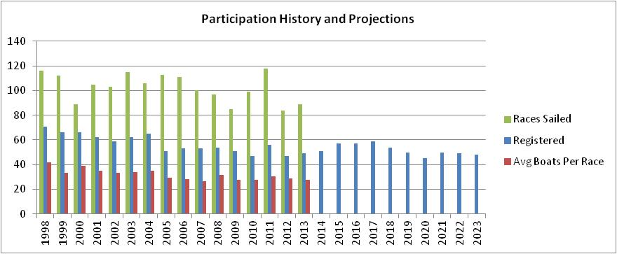
CLYC Overall
 | 1998 | 1999 | 2000 | 2001 | 2002 | 2003 | 2004 | 2005 | 2006 | 2007 | 2008 | 2009 | 2010 | 2011 | 2012 | 2013 | 2014 | 2015 | 2016 | 2017 | 2018 | 2019 | 2020 | 2021 | 2022 | 2023
Registered | 71 | 66 | 66 | 62 | 59 | 62 | 65 | 51 | 53 | 53 | 54 | 51 | 47 | 56 | 47 | 49 | 51 | 57 | 57 | 59 | 54 | 50 | 45 | 50 | 49 | 48
Races | 116 | 112 | 89 | 105 | 103 | 115 | 106 | 113 | 111 | 100 | 97 | 85 | 99 | 118 | 84 | 89
Participation Rate | 59% | 51% | 59% | 57% | 56% | 55% | 54% | 57% | 53% | 50% | 59% | 54% | 59% | 55% | 61% | 56%
Observations
Total registrations in 2013 down 31% since 1998, mainly due to decreases in E, C, and X fleets
Number of races conducted in 2013 down 23% since 1998, participation rate has remained stable
Projected registrations stable over the next 10 years, with growth between 2014-2017.

Slide 4
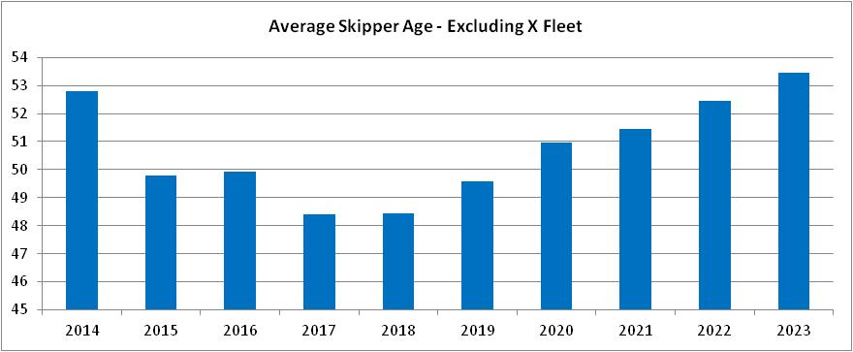
CLYC Overall
Observations
Net decrease of 18 skippers from 1998 – 2013
Projected net decrease of 1 skipper from 2014 - 2023
Average skipper age in adult fleets will grow from 48 to 54 years old over the next 10 years

Slide 5
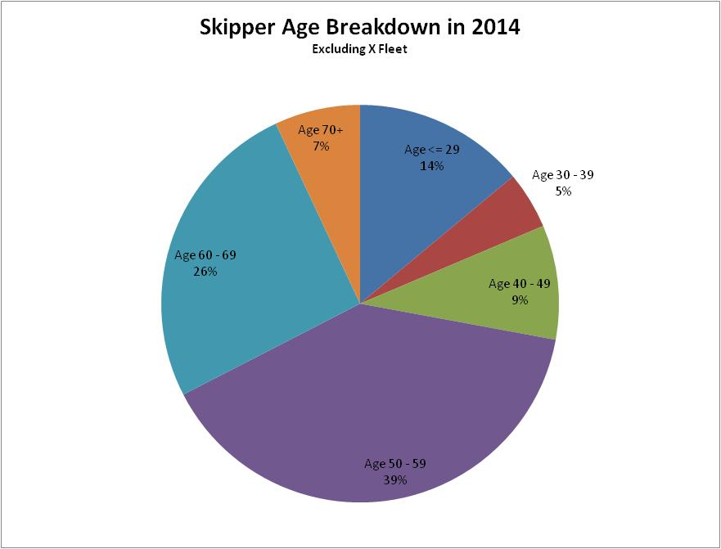
CLYC Overall
Observations
Almost 75% of skippers in 2014 will be age 50+
Lack of skippers between age 30 – 49.
Only 5 X skippers from 1998 – 2012 skippered in an adult fleet in 2013
In 2014, 2 more youth projected to skipper in an adult fleet
3
6
2
11
4
17

Slide 6
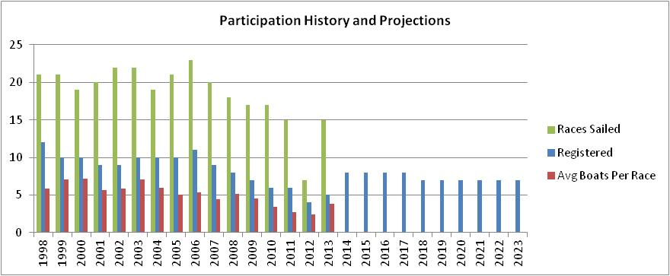
E Fleet
 | 1998 | 1999 | 2000 | 2001 | 2002 | 2003 | 2004 | 2005 | 2006 | 2007 | 2008 | 2009 | 2010 | 2011 | 2012 | 2013 | 2014 | 2015 | 2016 | 2017 | 2018 | 2019 | 2020 | 2021 | 2022 | 2023
Registered | 12 | 10 | 10 | 9 | 9 | 10 | 10 | 10 | 11 | 9 | 8 | 7 | 6 | 6 | 4 | 5 | 8 | 8 | 8 | 8 | 7 | 7 | 7 | 7 | 7 | 7
Races | 21 | 21 | 19 | 20 | 22 | 22 | 19 | 21 | 23 | 20 | 18 | 17 | 17 | 15 | 7 | 15
Participation Rate | 48% | 70% | 72% | 63% | 65% | 71% | 59% | 50% | 49% | 49% | 65% | 65% | 57% | 44% | 61% | 77%
Avg Boats Per Race | 6 | 7 | 7 | 6 | 6 | 7 | 6 | 5 | 5 | 4 | 5 | 5 | 3 | 3 | 2 | 4
Observations
Fleet almost died after 2012, but sailors who skipper in other fleets revived it in 2013
Fleet projected to grow to 8 boats in 2014, mainly consisting of sailors from other fleets
Participation rate hit a high in 2013 at 77%. Sunday afternoon races have been good for the fleet.

Slide 7
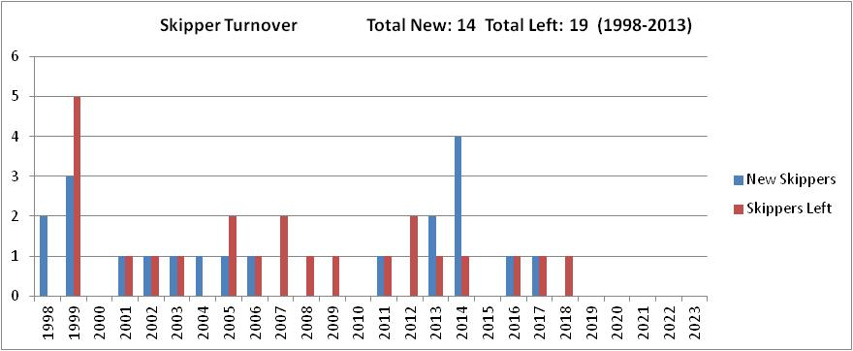
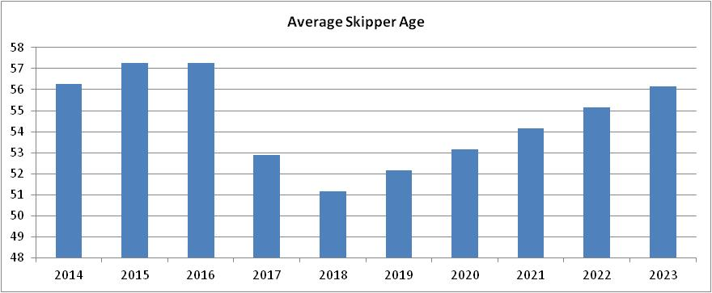
E Fleet
Observations
Net add of 3 new boats in 2014, and only a net loss of 1 skipper projected over the next 10 years
One youth projected to join fleet over the next 10 years

Slide 8
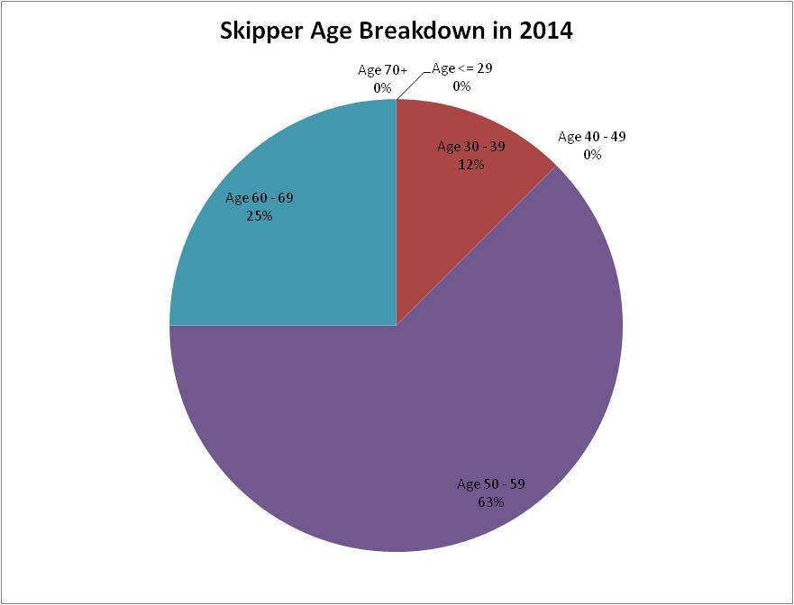
E Fleet
Observations
Skippers mainly 50+ years old
One youth skipper and multiple youth crew projected to become involved over next 10 years
1
2
5

Slide 9
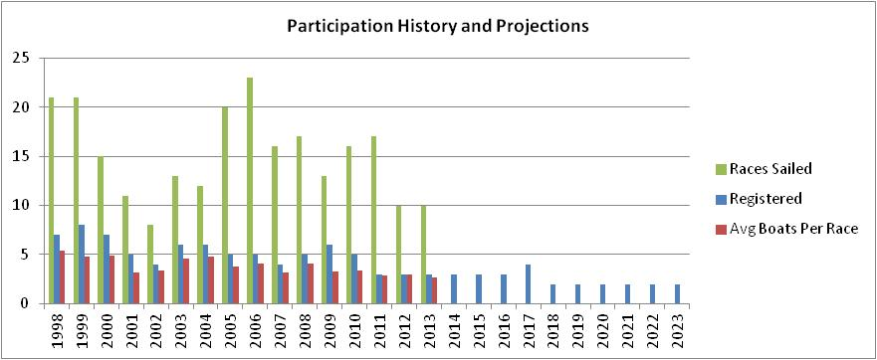
C Fleet
 | 1998 | 1999 | 2000 | 2001 | 2002 | 2003 | 2004 | 2005 | 2006 | 2007 | 2008 | 2009 | 2010 | 2011 | 2012 | 2013 | 2014 | 2015 | 2016 | 2017 | 2018 | 2019 | 2020 | 2021 | 2022 | 2023
Registered | 7 | 8 | 7 | 5 | 4 | 6 | 6 | 5 | 5 | 4 | 5 | 6 | 5 | 3 | 3 | 3 | 3 | 3 | 3 | 4 | 2 | 2 | 2 | 2 | 2 | 2
Races | 21 | 21 | 15 | 11 | 8 | 13 | 12 | 20 | 23 | 16 | 17 | 13 | 16 | 17 | 10 | 10
Participation Rate | 77% | 60% | 70% | 64% | 84% | 76% | 79% | 75% | 82% | 80% | 82% | 55% | 68% | 96% | 100% | 90%
Avg Boats Per Race | 5 | 5 | 5 | 3 | 3 | 5 | 5 | 4 | 4 | 3 | 4 | 3 | 3 | 3 | 3 | 3
Observations
Extremely high participation rate over the past years, number of races sailed is down in last 2 years
Registrations down to 3 over the past 3 seasons, but average boats per race only down 2 since 1998

Slide 10
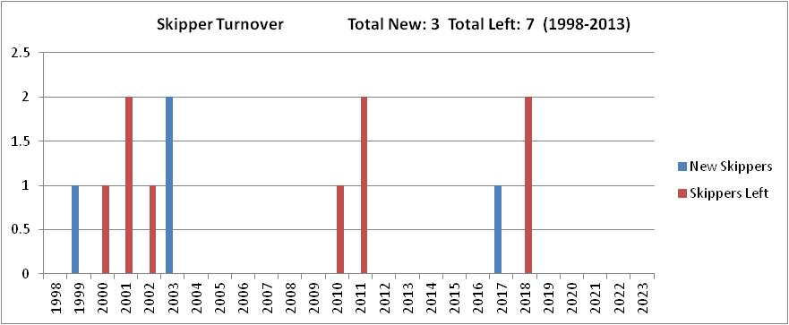
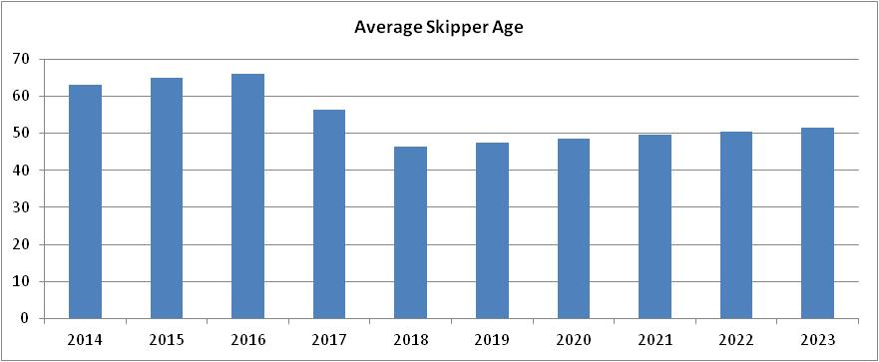
C Fleet
Observations
Fleet may die in 2018
One youth sailor expressed interest in joining the fleet in 2017

Slide 11
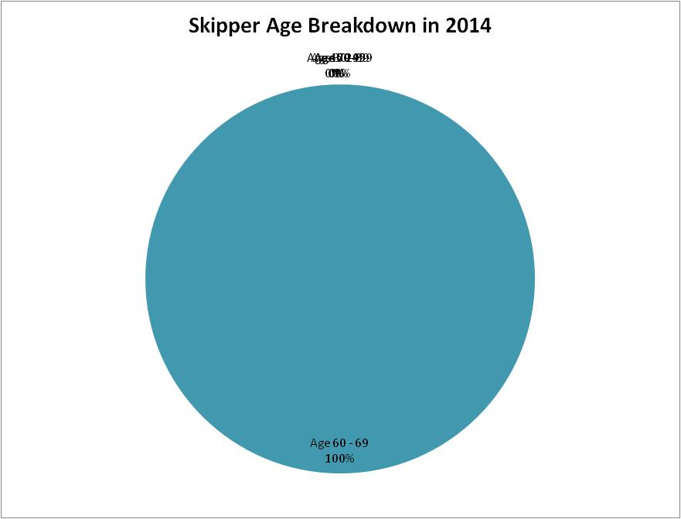
C Fleet
Observations
Fleet consists of three veteran C sailors
3

Slide 12
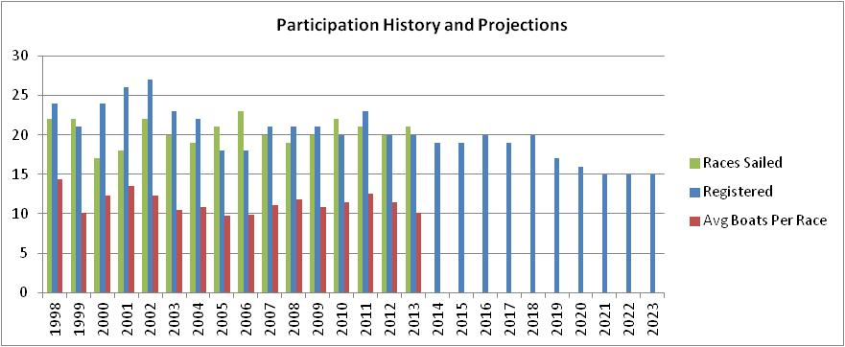
MC Fleet
 | 1998 | 1999 | 2000 | 2001 | 2002 | 2003 | 2004 | 2005 | 2006 | 2007 | 2008 | 2009 | 2010 | 2011 | 2012 | 2013 | 2014 | 2015 | 2016 | 2017 | 2018 | 2019 | 2020 | 2021 | 2022 | 2023
Registered | 24 | 21 | 24 | 26 | 27 | 23 | 22 | 18 | 18 | 21 | 21 | 21 | 20 | 23 | 20 | 20 | 19 | 19 | 20 | 19 | 20 | 17 | 16 | 15 | 15 | 15
Races | 22 | 22 | 17 | 18 | 22 | 20 | 19 | 21 | 23 | 20 | 19 | 20 | 22 | 21 | 20 | 21
Participation Rate | 60% | 48% | 51% | 52% | 45% | 45% | 50% | 54% | 55% | 53% | 56% | 52% | 57% | 54% | 57% | 51%
Avg Boats Per Race | 14 | 10 | 12 | 14 | 12 | 10 | 11 | 10 | 10 | 11 | 12 | 11 | 11 | 13 | 11 | 10
Observations
Registrations stable around 20 until 2018, and fleet will diminish to 15 by 2021 due to retirements
Participation traditionally about half the fleet in a given race, about 10 – 11 boats

Slide 13
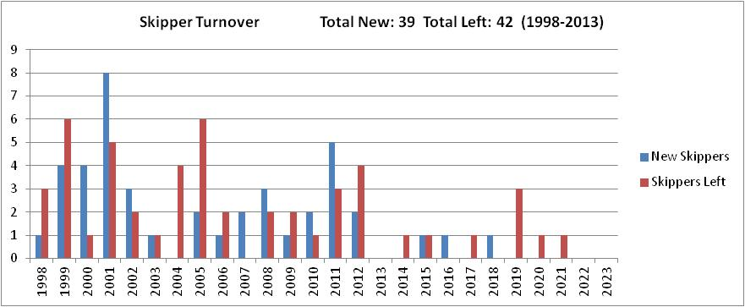
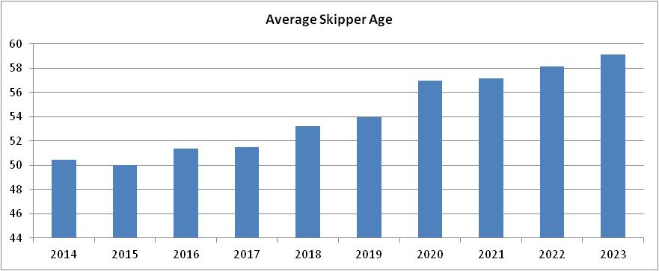
MC Fleet
Observations
Overall turnover relatively stable since 1998 to 2013
Over next 10 years, 3 projected to join the fleet and 8 will leave
Average skipper age grows from 51 in 2014 to 59 in 2023

Slide 14
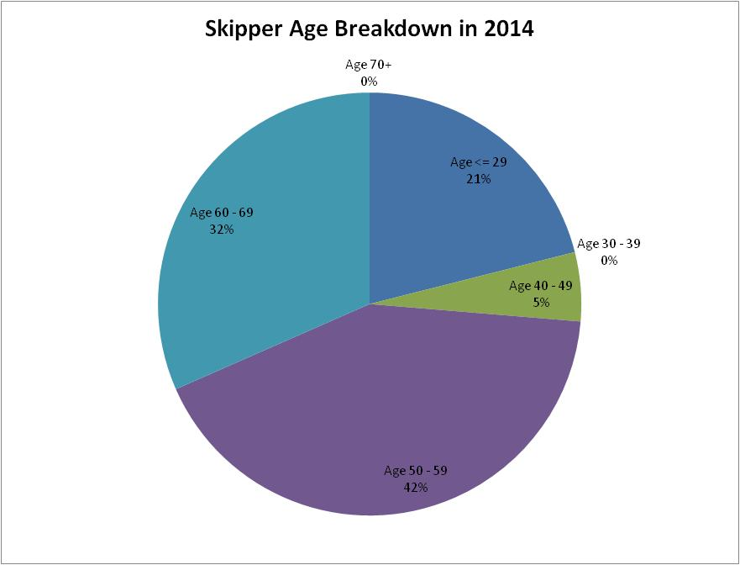
MC Fleet
Observations
Almost 75% of skippers are over 50
Three youth skippered in 2013 and one more projected to join in 2014
4
6
1
8

Slide 15
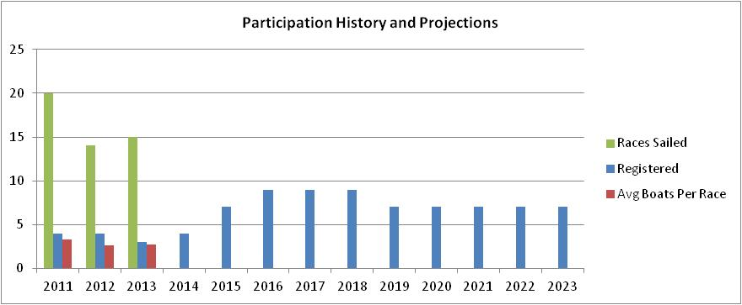
M17 Fleet
 | 2011 | 2012 | 2013 | 2014 | 2015 | 2016 | 2017 | 2018 | 2019 | 2020 | 2021 | 2022 | 2023
Registered | 4 | 4 | 3 | 4 | 7 | 9 | 9 | 9 | 7 | 7 | 7 | 7 | 7
Races | 20 | 14 | 15
Participation Rate | 83% | 66% | 91%
Avg Boats Per Race | 3 | 3 | 3
Observations
Projected registrations will triple fleet size by 2016
High participation rate

Slide 16
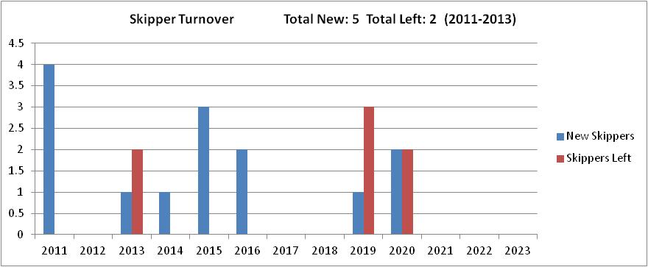
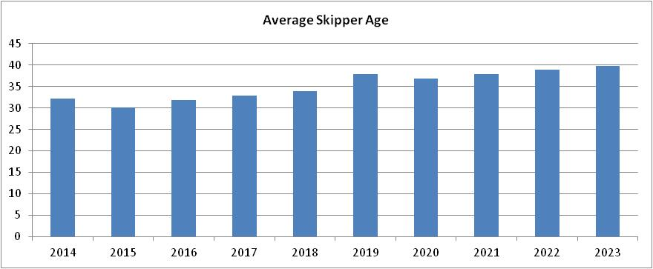
M17 Fleet
Observations
Six new skippers expressed interest in boats by 2016
Average skipper age projected to be 30 in 2015

Slide 17
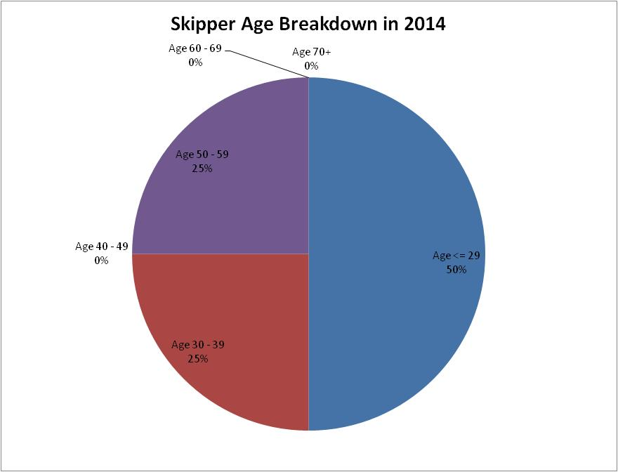
M17 Fleet
Observations
Youth projected to build this fleet
Many from X fleet have expressed interest
Of the 8 total sailors in the fleet in 2014, 5 of them are 15-22 years old
1
2
1

Slide 18
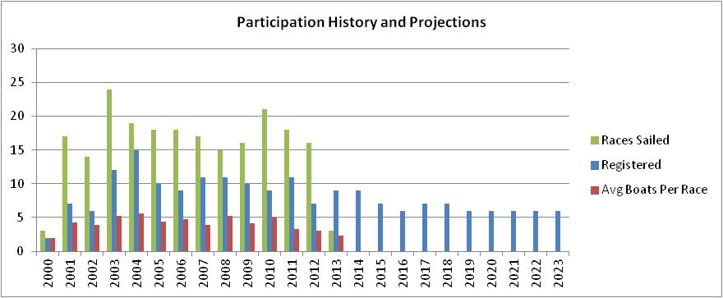
Hobie Fleet
 | 2000 | 2001 | 2002 | 2003 | 2004 | 2005 | 2006 | 2007 | 2008 | 2009 | 2010 | 2011 | 2012 | 2013 | 2014 | 2015 | 2016 | 2017 | 2018 | 2019 | 2020 | 2021 | 2022 | 2023
Registered | 2 | 7 | 6 | 12 | 15 | 10 | 9 | 11 | 11 | 10 | 9 | 11 | 7 | 9 | 9 | 7 | 6 | 7 | 7 | 6 | 6 | 6 | 6 | 6
Races | 3 | 17 | 14 | 24 | 19 | 18 | 18 | 17 | 15 | 16 | 21 | 18 | 16 | 3
Participation Rate | 100% | 61% | 64% | 43% | 37% | 43% | 52% | 36% | 48% | 42% | 56% | 30% | 44% | 26%
Avg Boats Per Race | 2 | 4 | 4 | 5 | 6 | 4 | 5 | 4 | 5 | 4 | 5 | 3 | 3 | 2
Observations
Fleet grew rapidly and peaked in registration in 2004. Stable registrations around 10 since then.
Registrations appear to be stable until 2023. Retirements from 3 seasoned veterans will occur.
Participation has been diminishing over the past years, hit an extreme low in 2013.

Slide 19
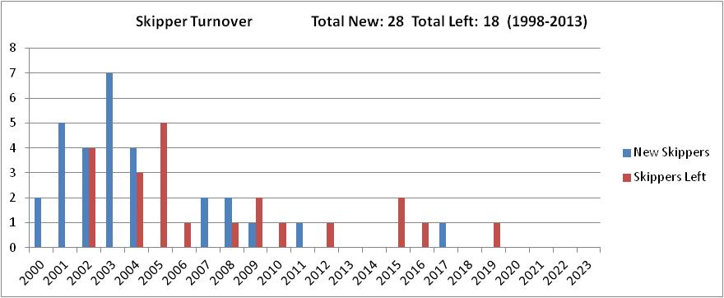
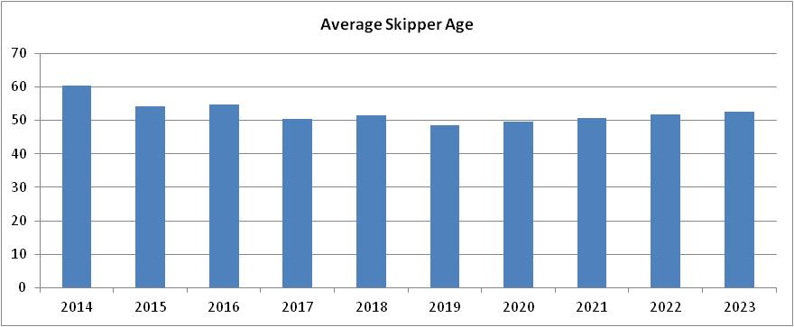
Hobie Fleet
Observations
Retirements from 3 seasoned veterans expected over the next 3 seasons
Average skipper age after those retirements will be about 50

Slide 20
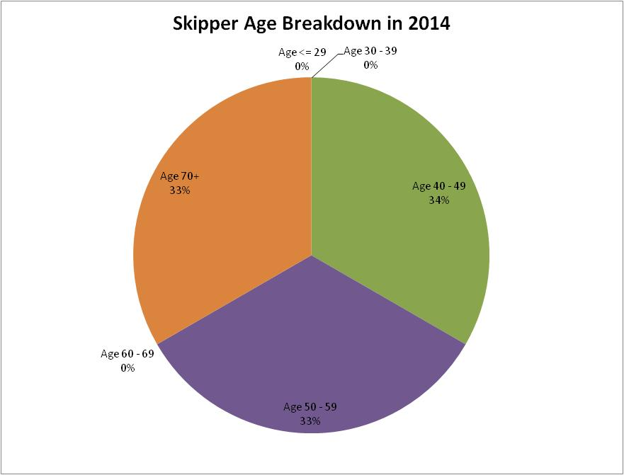
Hobie Fleet
Observations
Of the 3 70+ year olds, 2 are over 85.
Only 1 youth projected to join the fleet over the next 10 years
3
3
3

Slide 21
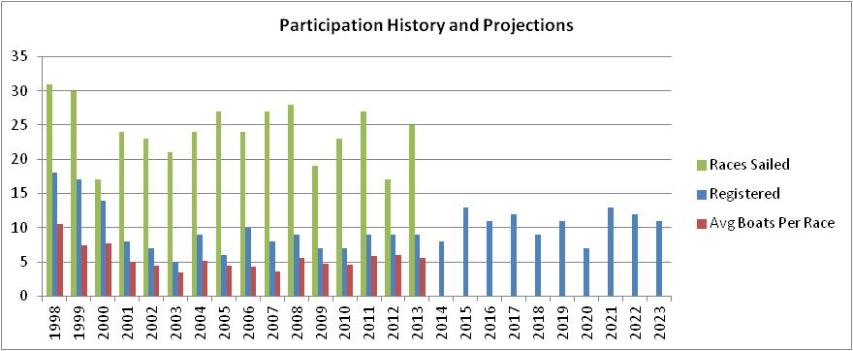
X Fleet
X
 | 1998 | 1999 | 2000 | 2001 | 2002 | 2003 | 2004 | 2005 | 2006 | 2007 | 2008 | 2009 | 2010 | 2011 | 2012 | 2013 | 2014 | 2015 | 2016 | 2017 | 2018 | 2019 | 2020 | 2021 | 2022 | 2023
Registered | 18 | 17 | 14 | 8 | 7 | 5 | 9 | 6 | 10 | 8 | 9 | 7 | 7 | 9 | 9 | 9 | 8 | 13 | 11 | 12 | 9 | 11 | 7 | 13 | 12 | 11
Races | 31 | 30 | 17 | 24 | 23 | 21 | 24 | 27 | 24 | 27 | 28 | 19 | 23 | 27 | 17 | 25
Participation Rate | 58% | 44% | 55% | 62% | 63% | 69% | 57% | 73% | 43% | 45% | 62% | 68% | 66% | 65% | 67% | 63%
Avg Boats Per Race | 11 | 7 | 8 | 5 | 4 | 3 | 5 | 4 | 4 | 4 | 6 | 5 | 5 | 6 | 6 | 6
Observations
Registration projections remain stable with modest growth over the next 10 years
Participation has increased over the past 6 years
Other ILYA lakes have seen X fleets diminish while ours has remained relatively strong

Slide 22
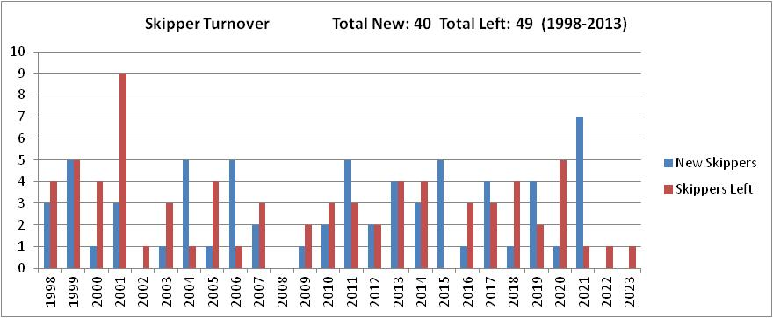
X Fleet
X
Observations
Only 5 X skippers from 1992 – 2012 skippered in an adult fleet in 2013
In 2014, 2 graduated X skippers started skippering in an adult fleet, and 1 more started crewing
Beyond 2014, 8 more kids have expressed interest in skippering in an adult fleet
More skippers will potentially join the X fleet than leave it in the next 10 seasons

Slide 23
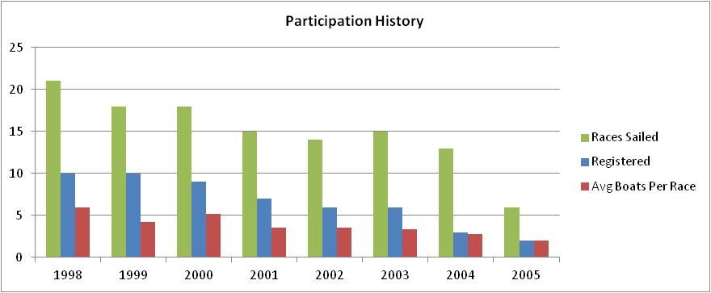
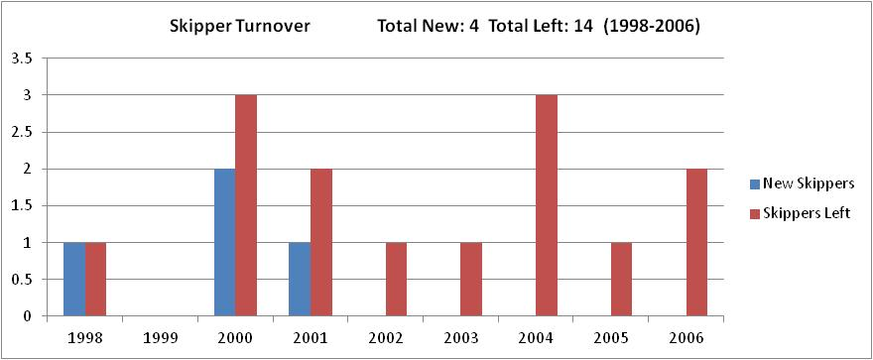
Cougar Fleet
Observations
Historical information only
Fleet died in 2006

Slide 24
Summary and Actions
In the next 10 seasons our racing membership appears to be stable, but will continue to age rapidly and decline unless more youth continue sailing.
Action: create a CLYC mentorship program. See below.
Action: create and maintain a CLYC Facebook page to better connect the CLYC with our youth.
The CLYC needs new crew involvement to build fleets and keep them healthy.
Action: resurrect & evangelize a crew wanted/interested page on the CLYC website.
Action: expose more people to racing through a “Watch the Races” program, where new folks join CLYC members on powerboats as spectators and can socialize and discuss the races.
The social aspect of racing forms friendships that can last a lifetime.
Action: Fleet captains should encourage and investigate ways our fleet members can socialize and learn from one another before and after races.
The club should focus energy on its strategic fleets:
The X fleet is our club’s strategic youth racing fleet. Optimists, 420s, and Hobie waves should compliment youth sailing experiences in the sailing school.
The M17, MC, and Hobie fleets are each unique and are strategic for our club. Each fleet gives our youth options upon graduation from the X. Create a CLYC mentorship program for these fleets:
M17, MC, and Hobie skippers will volunteer to be mentors and will be paired with interested X fleet mentees.
The mentorship will give mentees a greater understanding of the boats and will compliment the sailing school as a source of sailing expertise.
The E fleet is strategic and essential for our club, should be targeted for seasoned skippers, and allows greater participation among crew of various ages.
More people are involved in an E race due to crew. A race of 5 Es is 15-20 total people, which is about the same number of people in a race of 15 MCs.
The M17 is a pipeline for future E skippers.

Slide 25
Thank you to all CLYC racers who participated in this study!

